Slide 1

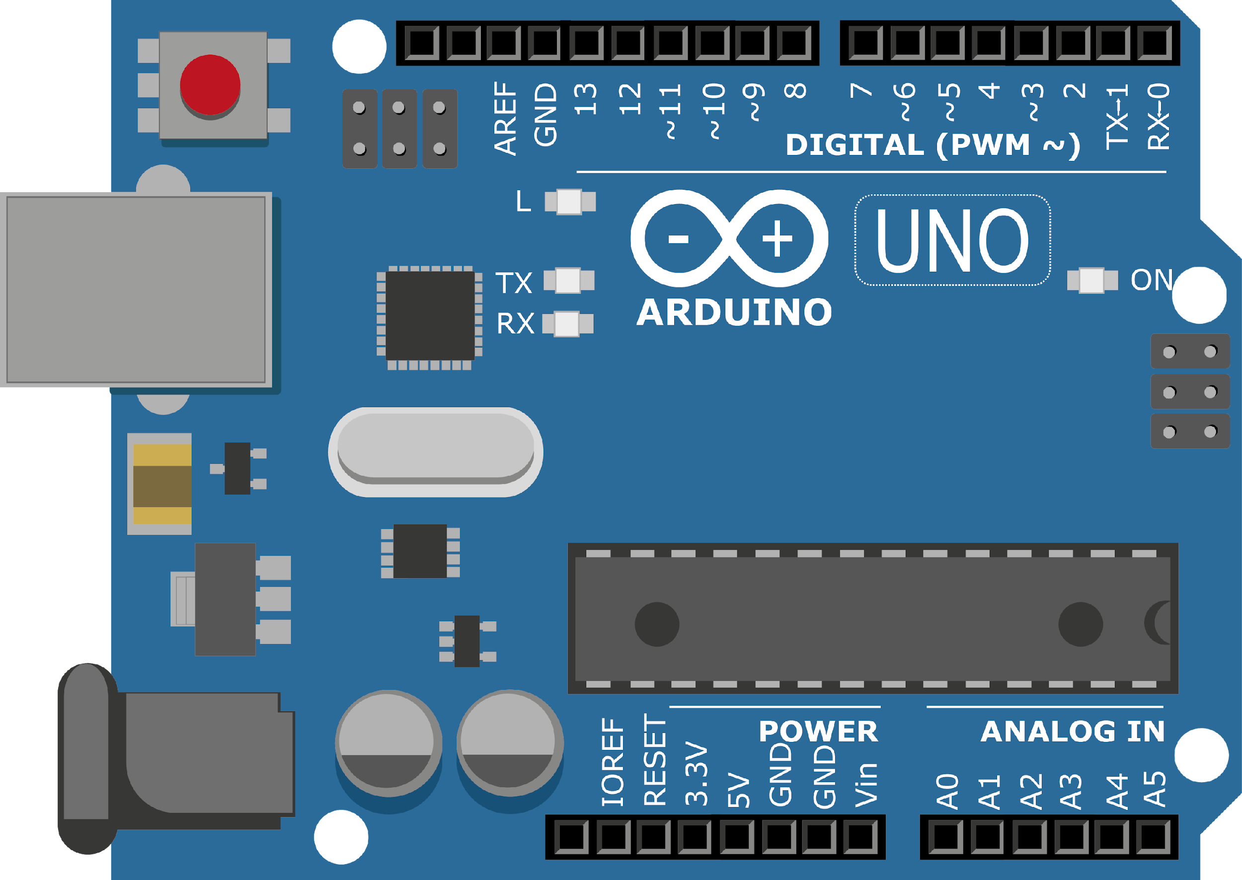
ARDUINO MASTER CLASS
03
Basic Embedded Application

Slide 2
3 AGENDA
02
03
01
Indication & Alert System
Overview on Digital I/O
digital I/O & Serial

Slide 3
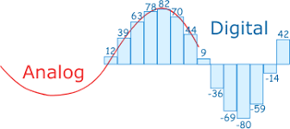
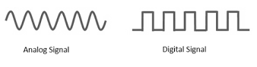
Overview on analog & digital

Slide 4
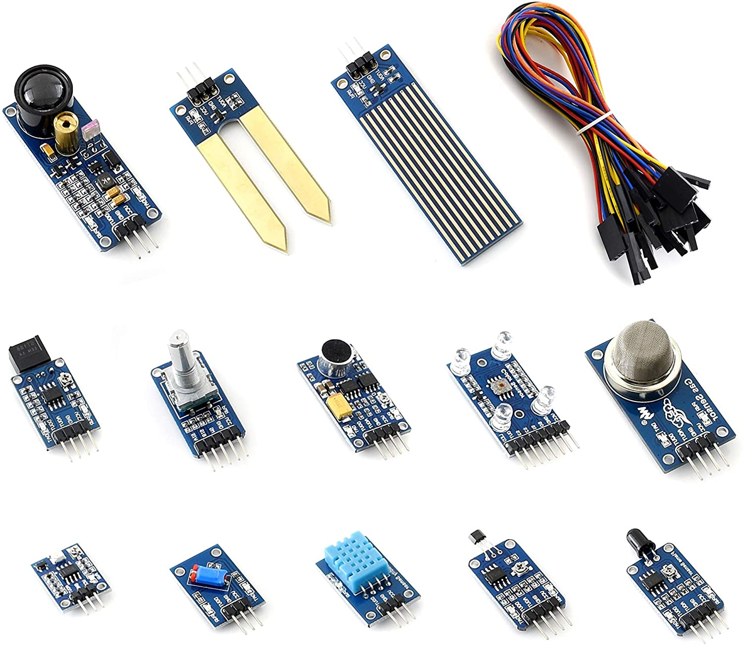
Exploring Sensors

Slide 5
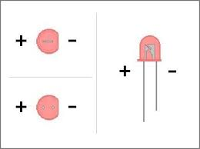
LED – Light Emitting Diode
LED is a semiconductor device that emits light when an electric current is passed through it.
Light is produced when the particles that carry the current (known as electrons and holes) combine together within the semiconductor material.

Slide 6
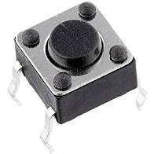
switch
Switch is an electrical component that can disconnect or connect the conducting path in an electrical circuit, interrupting the electric current or diverting it from one conductor to another.

Slide 7
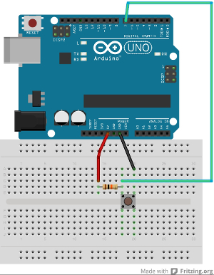
Controlling Switch
Reset Switch & 1K Ohm (Brown, Black, Red)

Slide 8
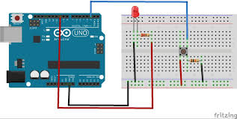
Controlling LED & Switch
3mm LED & 330 Ohm (Orange, Orange, Brown)

Slide 9
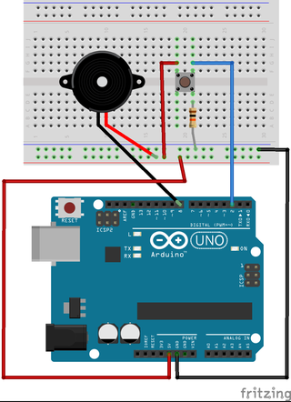
Controlling Buzzer & Switch

Slide 10

INTERVIEW QUESTIONS
why resistor is used in led?
What should be the biasing of the LED ?
What are Active and Passive components?
The ballast resistor is used to limit the current through the LED and to prevent that it burns. If the voltage source is equal to the voltage drop of the LED, no resistor is required.
Active components - require an external source for its full operation such as Diode, Transistor, Thyristor etc.
Passive components - do not need any external source for its function. Example of passive components is resistor, capacitor & Inductor.
Forward Bias

Slide 11
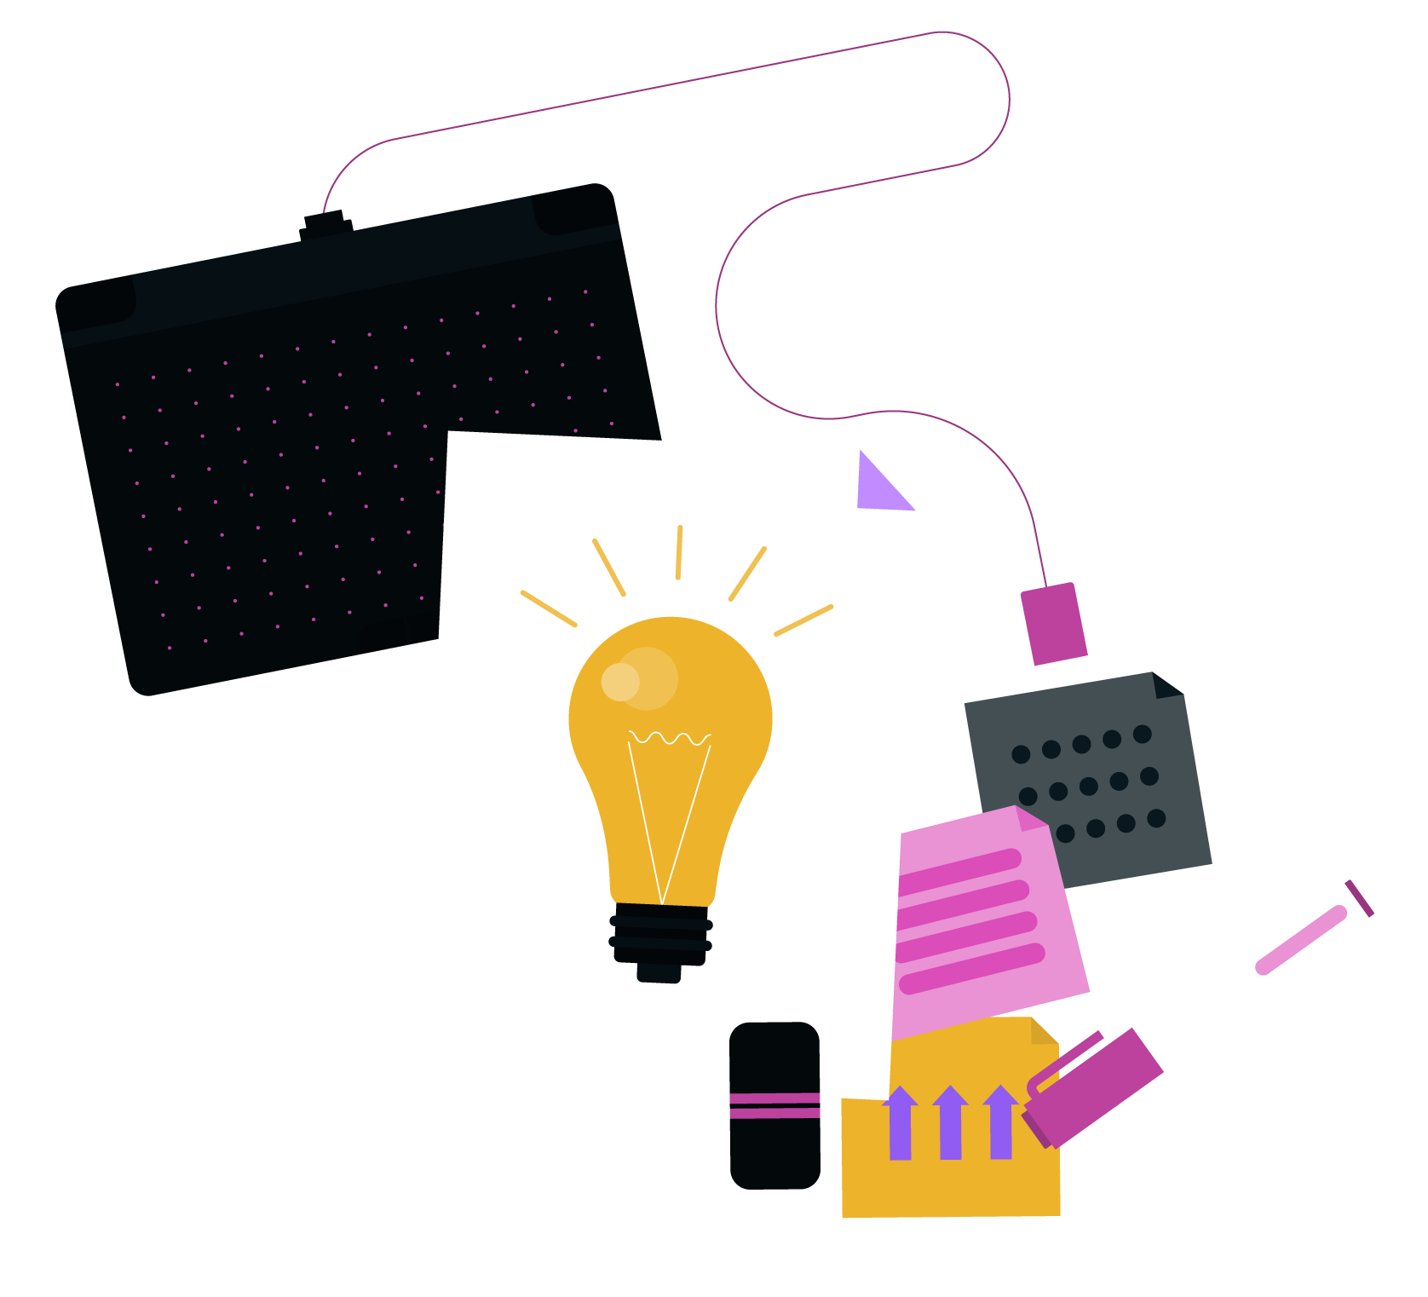
THANKS!

